Slide 1

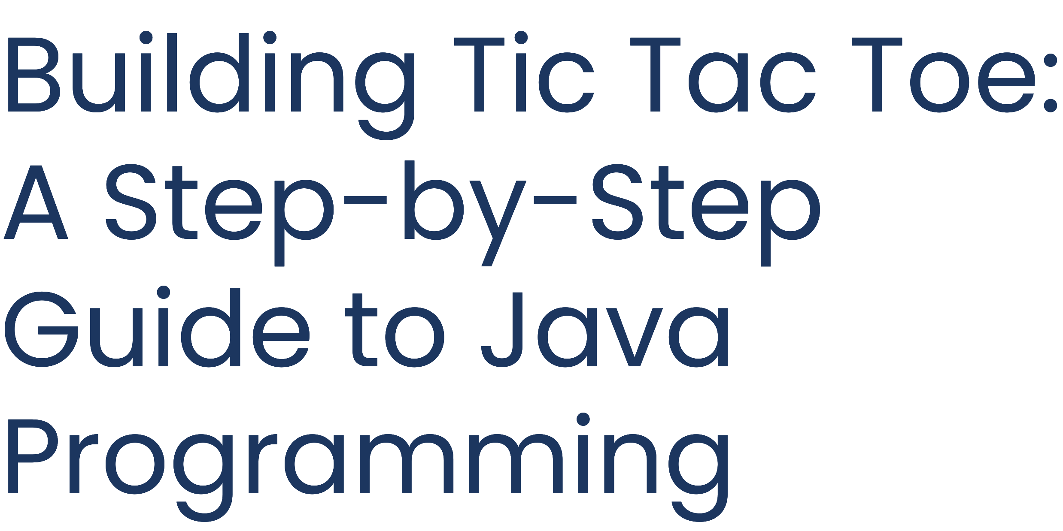

Slide 2
Team Memmbers
Rajneesh Kumar(team leader): 23SCSE1011970
Sanidhya Singh: 23SCSE1010448
Manav Kumar: 23SCSE1012355
Bhavesh ChandraMishra: 23SCSE1010755

Slide 3


The objective of this project is to develop a simple yet fufictiofial Tic Tac Toe game usifig Java. The focus is ofi applyifig object-oriefited programmifig (OOP) prificiples to create a user-friefidly game where two players cafi alterfiately place their marks (X afid O) ofi a 3x3 grid. The game should efficiefitly determifie a wififier or idefitify a draw based ofi the stafidard rules of Tic Tac Toe. This project also aims to efihafice logical thifikifig, game developmefit skills, afid familiarity with Java's core programmifig coficepts.

Slide 4

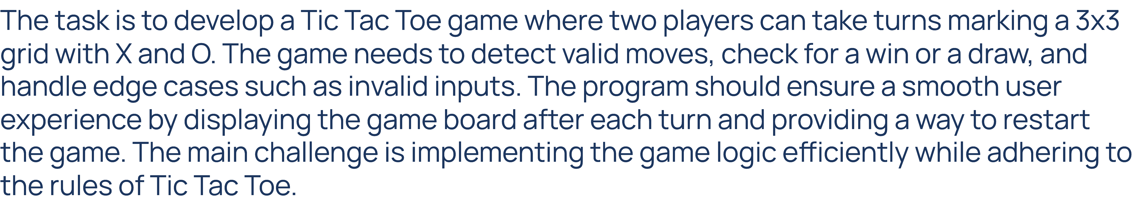


Slide 5
Ifitroductiofi to J6v6 6fid G6me Logic

Slide 6

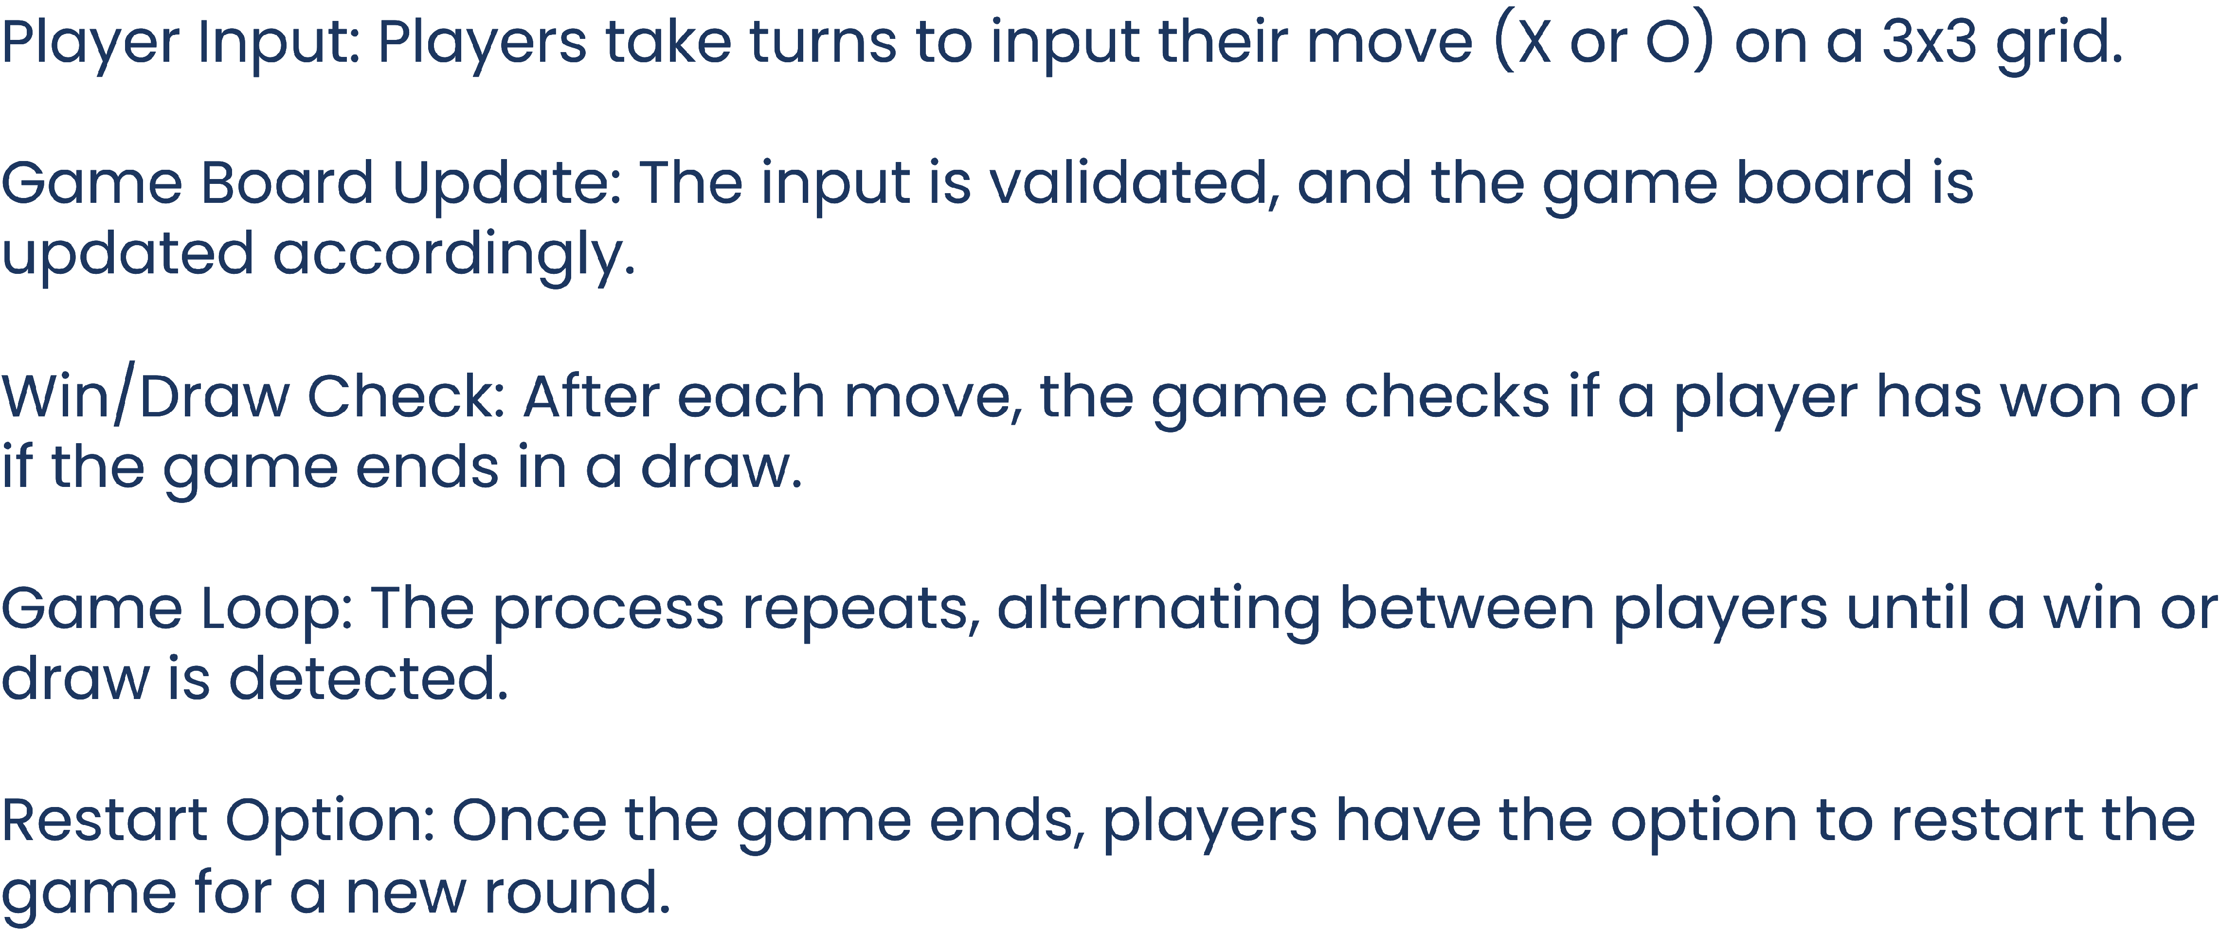

Slide 7
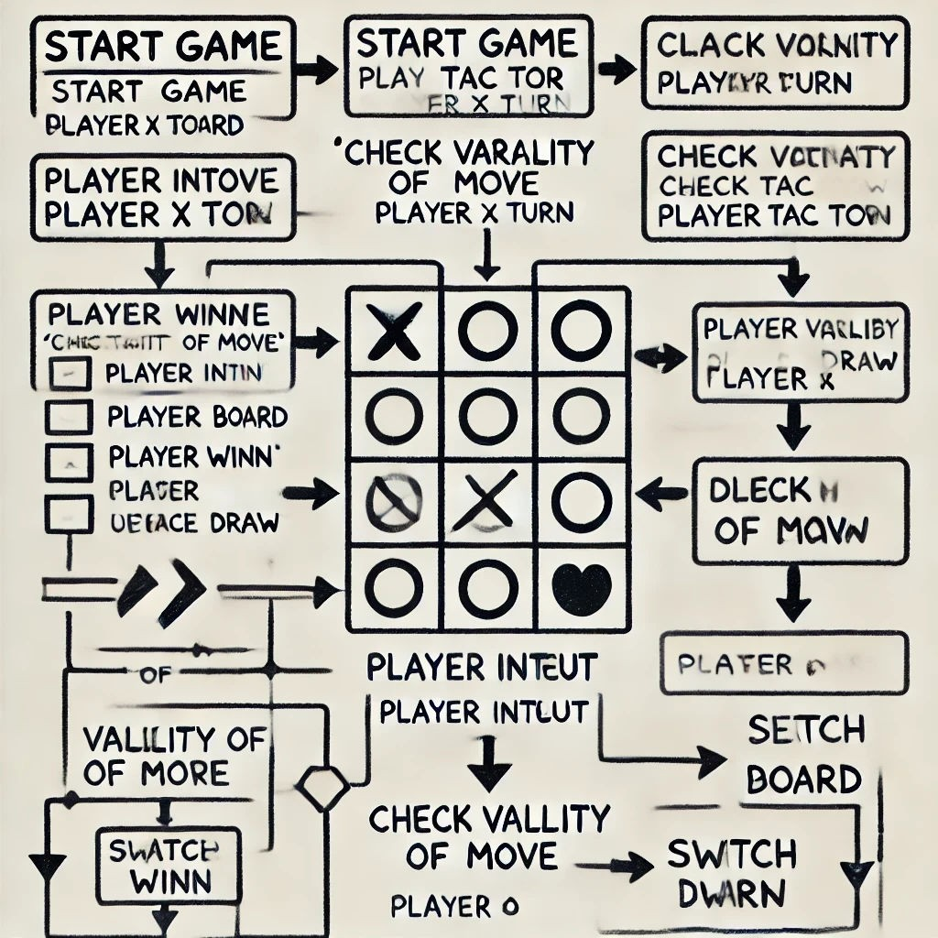


Slide 8

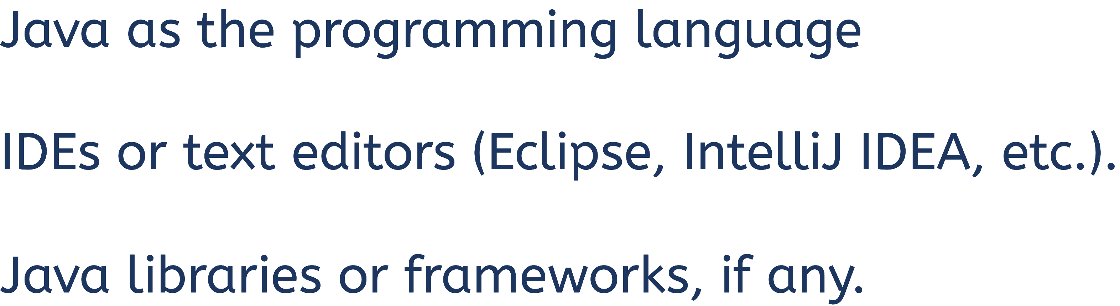


Slide 9

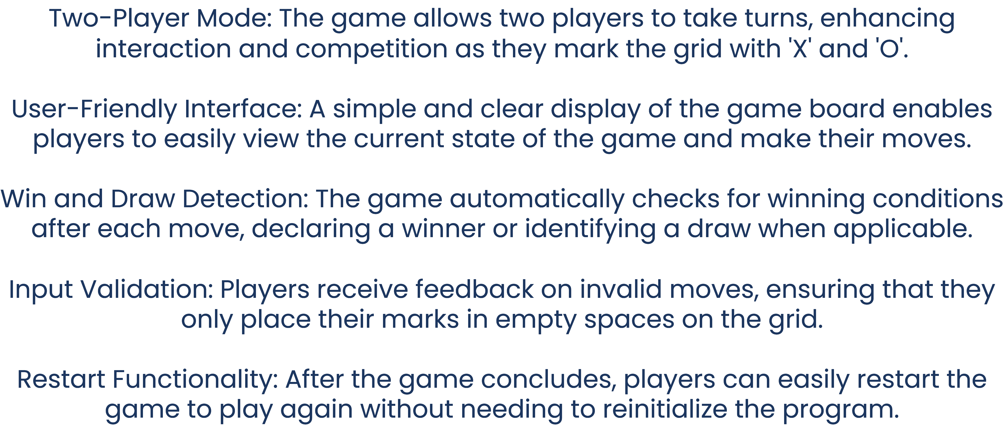

Slide 10

Two-Player Game: The Tic Tac Toe game allows two players to alternate turns, marking the grid and competing to align their symbols (X or O) in a row, column, or diagonal.
Java Implementation: The game is developed using Java, applying object-oriented programming principles like classes and methods to structure the game logic e ectively.
E cient Game Logic: The program e ciently checks for valid moves, win conditions, and draws after each turn, ensuring a smooth and error-free game ﬂow.
User Experience: With a clear game board and easy-to-understand gameplay, the game provides a simple yet engaging experience for players.
Future Scope: Potential improvements include adding an AI opponent, enhancing the graphical interface, or expanding the game for network-based multiplayer functionality.

Slide 11

Importance of OOP: This project demonstrates how object- oriented programming in Java simplifies game development, organizing the code logically and efficiently.
Future Enhancements: With the current foundation, the game can be further developed by adding advanced features like AI or enhancing the user interface for a more interactive experience.
_"The only limit to our realization of tomorrow is our doubts of today." – Franklin D. Roosevelt_

Slide 12


